Slide 1
Hypertrophic Cardiomyopathy

Slide 2
Definition
Genetic disease of heart muscle characterized by left ventricular hypertrophy in absence of another cardiac or systemic disease; variable morphologies
Maximal LV wall thickness > 15 mm
Clinical manifestations and hemodynamic abnormalities are manifold
Biggest fear is sudden cardiac death in young, athletic population 2/2 ventricular fibrillation

Slide 3
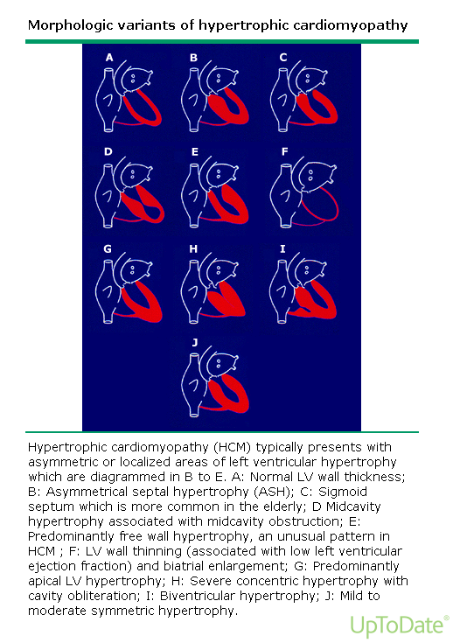
Morphologies

Slide 4
Etiology
Genetically Determined (60 – 70%)
Autosomal Dominant, variable expressivity, high degree of penetrance
Mutations involve of one of several sarcomere genes
11+ causative genes with 1400+ mutations have been reported

Slide 5
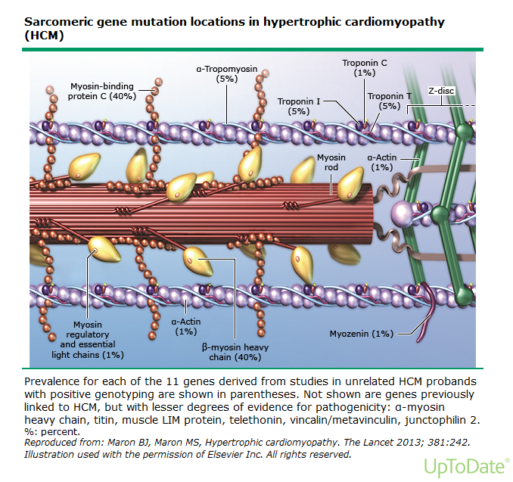
Sarcomere

Slide 6
Non-sarcomeric Causes of LVH
Fabry Disease (alpha-galactosidase A deficiency, lysosomal storage disorder)
Noonan Syndrome (AD, facial dysmorphism)
Mitochondrial disease
Multiple other myocardial storage disorders
Important to differentiate because progression and management are vastly different

Slide 7
Common Differential Diagnosis
Hypertensive Heart Disease
Athlete’s Heart
Can usually be distinguished by family history, LV cavity dimension, diastolic function, and pattern of LV hypertrophy

Slide 8
Pathogenesis Proposal
Variable calcium sensitivity of myosin fibers
Variability from fiber to fiber generates force imbalances
This yields contractile dysfunction, disarray within the myocardium, and disordered cardiac remodeling

Slide 9
Development
Phenotypic development of left ventricular hypertrophy begins in puberty
Wall thickness development is usually complete by adulthood
ie: In most cases, not a progressive disease
Can be compatible with normal longevity
Portion of patients are at risk for disease-related complications
Progressive heart failure symptoms with systolic dysfunction
Atrial fibrillation with thromboembolic stroke risk

Slide 10
Prevalence
Quintessential Phenotype of HCM
0.2 % or 1:500 in general population worldwide
At least 600,000 people affected in United States

Slide 11
Physiologic Abnormalities
LV Outflow Obstruction
Diastolic Dysfunction
Myocardial Ischemia
Mitral Regurgitation

Slide 12
Symptoms Categorized
Heart Failure
Chest Pain
Arrhythmia
Increased incidence of supraventricular and ventricular arrhythmias
Hence, increased risk for SCD

Slide 13
Presentation
Fatigue
Dyspnea
Chest Pain
Palpitations
Presyncope/syncope
INDEX OF SUSPICION MUST BE HIGH IN YOUNG ATHLETE WITH THESE SYMPTOMS

Slide 14
Diagnosis
Echocardiography
Cardiac MR is indicated if echo is inconclusive for diagnosis
Unexplained LVH, often asymmetric
Genetic testing is becoming more available to identify those that carry disease-causing mutation in absence of LVH

Slide 15
Work-up
12-lead EKG
24 Hour Ambulatory (Holter) EKG is recommended in initial evaluation and every 1 to 2 years
Detect ventricular tachycardia
Identify candidates for ICD therapy
Echo every 1 to 2 years is reasonable in symptomatically stable patients
Exercise stress Echo to evaluate LVOT obstruction

Slide 16
Genetic Testing
DNA testing is available incorporating most common mutations
This is complicated though
Interpretation of results is sometimes equivocal
If a pathogenic mutation is identified in one family member, then all family members without

Slide 17
SCD Risk Stratification
Personal history of ventricular fibrillation, sustained VT, or SCD
Family history for SCD events
Unexplained syncope
Documented non-sustained VT (Holter)
Maximal LV wall thickness >30 mm
Blood pressure response during exercise
Invasive EP testing as routine SCD risk stratification should NOT be performed

Slide 18
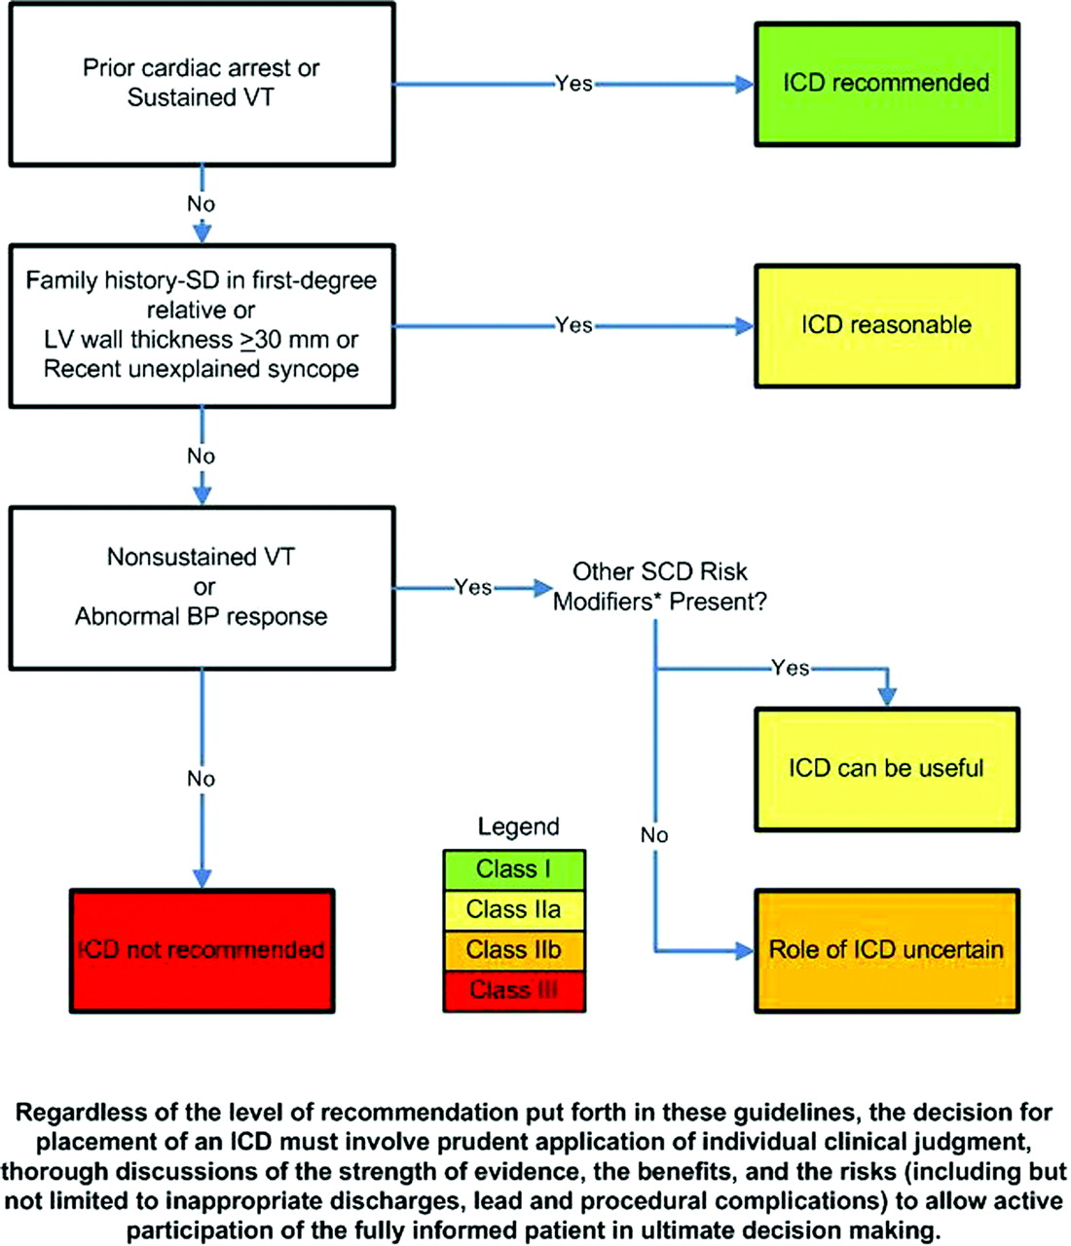
ICD Algorithm

Slide 19
Participation in Sports
Reasonable for patients with HCM to participate in low-intensity sports
Golf, bowling, skating, swimming, biking
Patients with HCM should NOT participate in intense competitive sports regardless of age, sex, race, presence of LVOT obstruction, prior reduction therapy, or ICD implanatation

Slide 20
ACCF/AHA Guidelines—Family
Class I Recommendations
In patients with HCM, evaluation of familial inheritance and genetic counseling is recommended (Level of Evidence: B)
Screening (clinical +/- genetic testing) is recommended in first-degree relatives of patients with HCM (Level of Evidence: B)
Clinical Screening includes:
12-lead EKG and echo 12 to 18 months for adolescents starting at age 12
Echocardiogram as initial screening for first-degree family members
Regular follow up

Slide 21
ACCF/AHA Guidelines—Family
Class IIa
Genetic testing is reasonable in the index patient to facilitate the identification of first-degree family members at risk for developing for HCM (Level of Evidence: B)
Class IIb
The usefulness of genetic testing in the assessment of risk for SCD in HCM is uncertain (Level of Evidence:B)

Slide 22
ACCF/AHA Guidelines—Family
Class III: No Benefit
Genetic testing is not indicated in relatives when the index patient does not have a definitive pathogenic mutation (Level of Evidence: B)
Ongoing clinical screening is not indicated in genotype-negative relatives in families with HCM (Level of Evidence: B)

Slide 23
ACCF/AHA Guidelines—Echo
TTE recommended at initial evaluation of all patients with suspected HCM
Repeat TTE is recommended for evaluation of patients with HCM and a change in clinical status
TTE should NOT be performed more frequently than every 12 months when it is unlikely to have impact on clinical decision making

Slide 24
Pharmacologic Management
Beta-blockers for treatment of angina or dyspnea in adults
Caution with sinus bradycardia or severe conduction disease
Can titrate to HR of less than 60 – 65\
Verapamil
Can add disopyramide and diuretics
Usefulness of ACE inhibitors is questionable

Slide 25
Pharmacologic Management
Do NOT use DHP calcium channel blockers (eg: nifedipine)
Verapamil potentially harmful
Digitalis potentially harmful
Dopamine, dobutamine, norepi are potentially harmful for acute hypotension with HOCM (use phenylephrine IV)

Slide 26
Invasive Therapies
Septal Myomectomy
Alcohol Septal Ablation
Severe, drug-refractory symptoms and LVOT obstruction
Severe dyspnea, NYHA III or IV, syncope, affects ADLs
Severe Hemodynamic

Slide 27
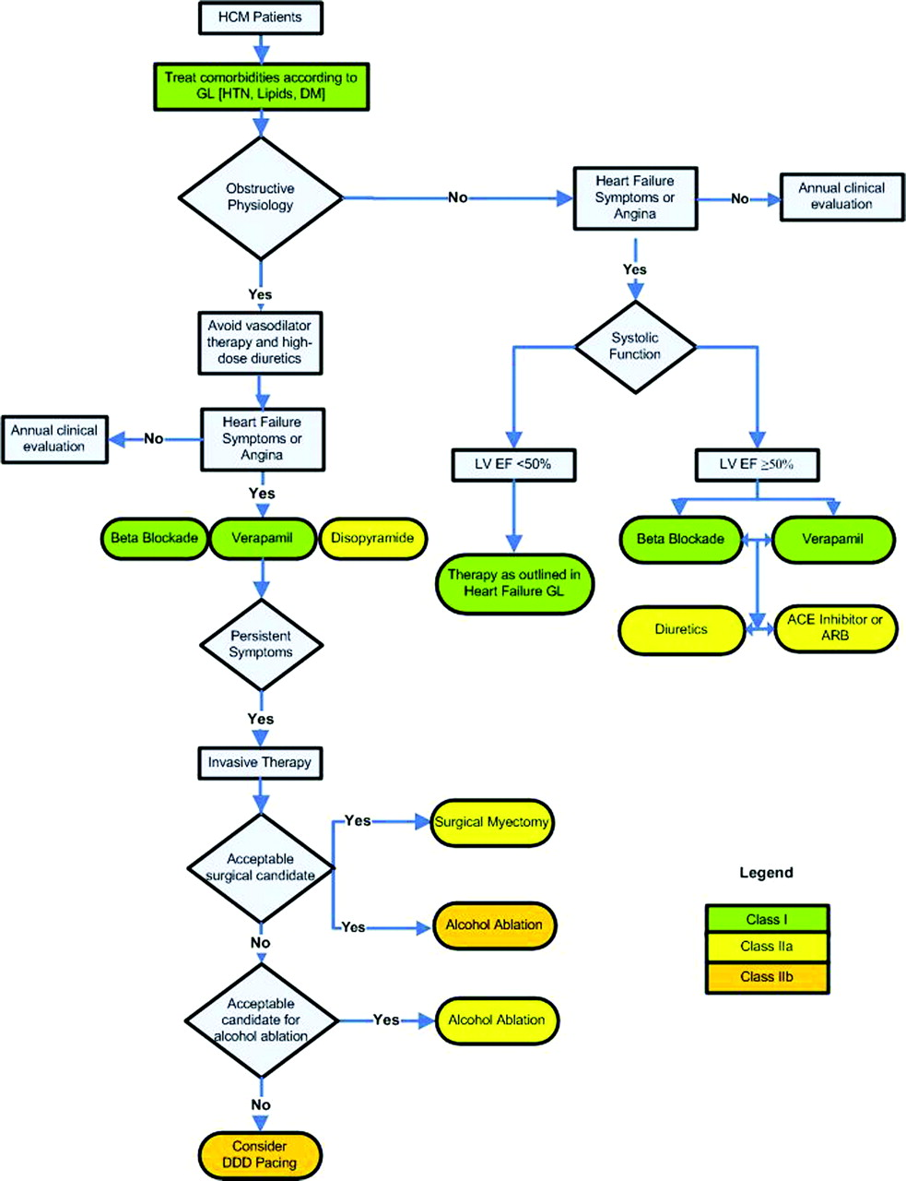
Treatment

Slide 28
Heart Transplantation
Patients with advanced heart failure and non-obstructive HCM recalcitrant to other interventions with EF < 50 % should be considered
Should NOT be performed in mildly symptomatic

Slide 29
References
2011 ACCF/AHA Guideline for the Diagnosis and Treatment of Hypertrophic Cardiomyopathy. http://circ.ahajournals.org/content/124/24/2761.full
Maron, Elliott et al. Clinical Manifestations, Diagnosis, and Evaluation of Hypertrophic Cardiomyopathy. Dec 18, 2014. uptodate.com.
Maron, Martin S. Medical Theraphy in Hypertrophic Cardiomyopathy. Jan 08, 2014. uptodate.com

